Slide 1
CSE 20 Discussion - Week 6
Sets and (More) Proofs

Slide 2
Administrative Stuff
HW 4 late submission for extenuating circumstances (no penalty and do not need to let us know): Thursday at 8 AM
Project Part 2 due at 11 PM on Thursday
Discussion is recorded and optional

Slide 3
Agenda
Sets
Properties of sets
Proof by Structural Induction

Slide 4
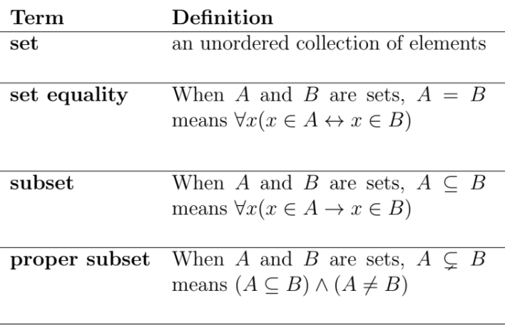
Sets and Related Definitions

Slide 5
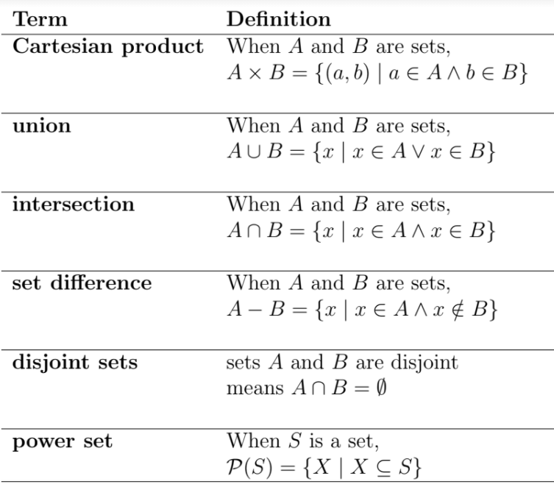
Definitions of Set Operations

Slide 6
Problem 1a - Sets

Slide 7
Problem 1a - Sets

Slide 8
Problem 1b - Sets

Slide 9
Problem 1b - Sets

Slide 10
Problem 1c - Sets

Slide 11
Problem 1c - Sets

Slide 12
Problem 1d - Sets

Slide 13
Problem 1d - Sets

Slide 14
Structural Induction

Slide 15
Problem 2 – Structural Induction
Textbook: page 358, problem 27
Use structural induction to show that a ≤ 2b whenever (a, b) ∈ S.

Slide 16
Problem 2 – Structural Induction

Slide 17
Problem 2 – Structural Induction

Slide 18
Problem 2 – Structural Induction

Slide 19
Problem 2 – Structural Induction

Slide 20
Problem 2 – Structural Induction

Slide 21
Problem 2 – Structural Induction

